Slide 1
Unit testing
Locke
locke12456@gmail.com

Slide 2
Outline
Introduction
Integration Testing
Unit Testing
Software Testing
TDD
Test case
Unit test
Stub & Mock
Test Case Writing
Unit test Framework - cmockery
Tool – CTestCaseGen
Example : SemaApi

Slide 3
Integration Testing
testing a GUI or a GUI-based application.
testing a command line utility.
testing a subsystem
testing a scenario, such as a Happy Path, then each variation or unhappiness.
Notes:
首先，我們先釐清甚麼是整合測試和單元測試。
很多人以為自己寫的是單元測試，可是做的其實是整合測試。
就是說只是在側功能會系統能不能動而已。
這邊舉了幾個例子，GUI的整合測試。
測Command line程式的功能、測子系統，像是附屬的libraries之類的。
或者是驗證一個必定成功或者必定失敗的scenario。天時地利人和之類的。

Slide 4
Testing a GUI or a GUI-based application.
Testing a GUI or a GUI-based application should not require a tool for recording and replaying GUI events such as keystrokes, mouse movements and mouse clicks, but the hooks for UnitTesting of GUI controls are often not accessible or productized.

Slide 5
Testing a command line utility
testing a command line utility should not require make and/or shell scripts, then "diff" or "cmp" to see if the output is the same as the GoldenStandard or not.

Slide 6
Testing a subsystem
A library or a component of a library
Requires a scaffolding program to call the methods/functions with various parameters and check return values. And this scaffolding only requires extending that library's copious UnitTests.

Slide 7
Unit test
Fast
Timely
Independent
Self-Validating
Repeatable
Notes:
Fast：快速。
Independent：獨立。
Repeatable：可重複。
Self-Validating：可反應驗證結果。單元測試不論成功或失敗，都應該要從測試的 reporting 直接瞭解其意義或失敗原因。
Timely：及時。單元測試應該恰好在使其通過的 production code 之前撰寫。

Slide 8
Unit & Unit test
Unit
Unit test
Notes:
Unit test必須涵蓋住整個unit
Unit -> link
講unit test之前，我要稍微提一下TDD的概念。

Slide 9
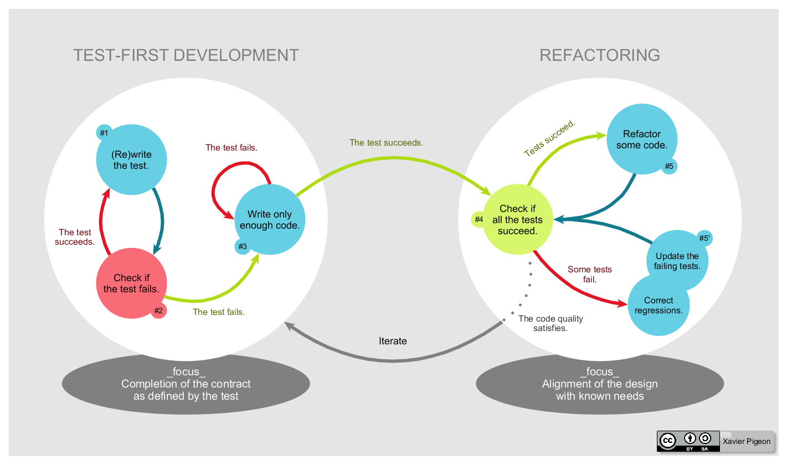
Software Testing
TDD (Test-driven development)
Think First, Code Later

Slide 10
Write some code
Clean Code: A Handbook of Agile Software Craftsmanship
Add a test
Run tests
Refactor code
Run all tests and see if the new one fails

Slide 11
Unit
Func.c
bool Func( input , output )
Block 1
Code ..
Block 2
Code …
Final
Return …
Notes:
Unit代表一個unit test的最小單位，他可能是一個C的function，也可能是整個C的file。

Slide 12
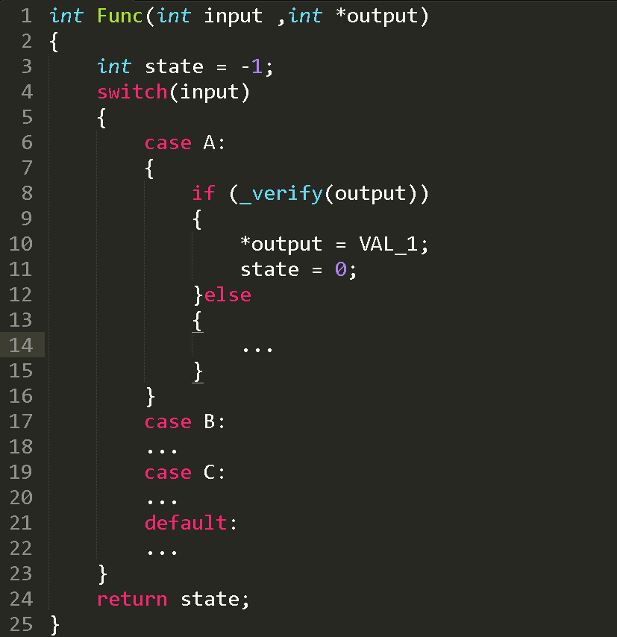
Many more possible states

Slide 13
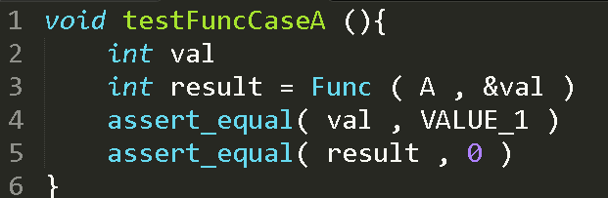
Unit test
Unit tests prove that the code you are testing does in fact do what you expect it to do.
Unit test case
Function

Slide 14
memory.h
driver.h
api.h
Func.c

Slide 15
Unit testing C code
Unit
Function
Notes:
以C來講，最小單位就是function
可是function可大可小，所以

Slide 16
Unit testing C code
Func.c
bool FunctionA
pass
Buf = malloc(size)
cmd = _func_cmd()
pass
Ret = driver(cmd , Buf)
…
pass
Ret = api_a(Buf)
return Ret
Notes:
我認為最小單位應該定成，一個.c file

Slide 17
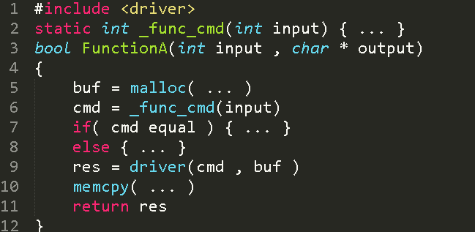

Slide 18
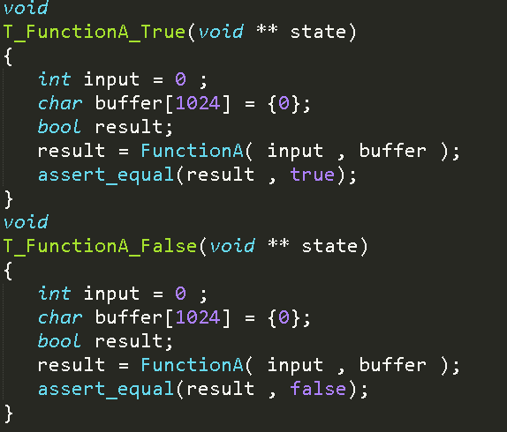

Slide 19
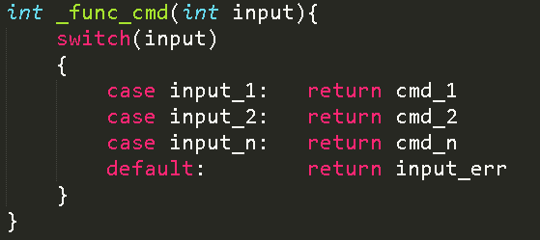





Slide 20
Stub & Mock
Stub
Dependencies
Global Variables, Environment Variables
Initialize functions
Test case
Call
Target object
Return

Slide 21
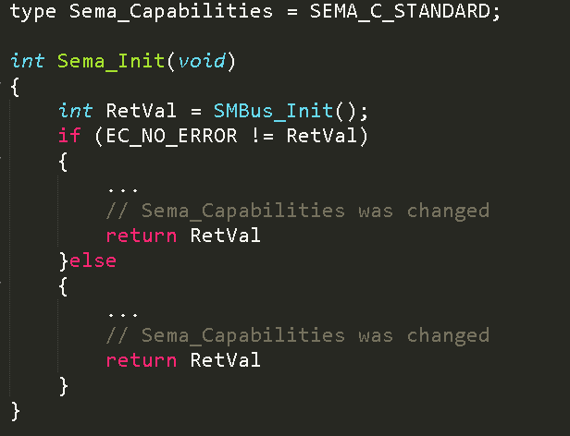
Stub example

Slide 22
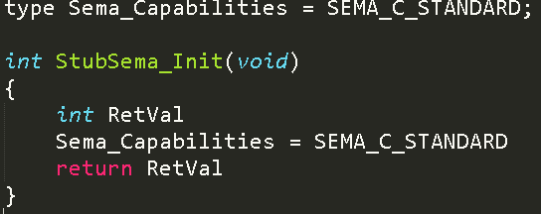
Stub example

Slide 23
Stub & Mock
Mock
Dependencies
Hardware dependency
Environment dependency
Test case
Call
Target object
Dependent object
Return

Slide 24
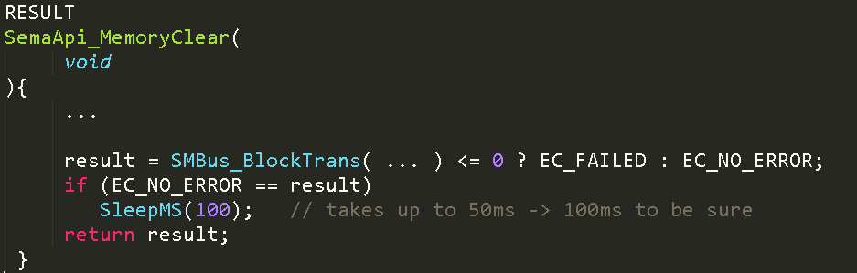
Example 1.

Slide 25
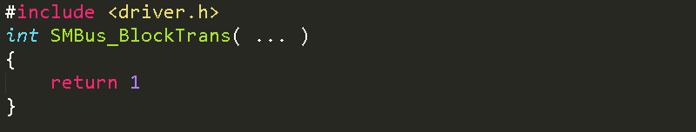
Example 1.
driver.so or
driver.a
mock.c
Linker
Test case
Target.c

Slide 26
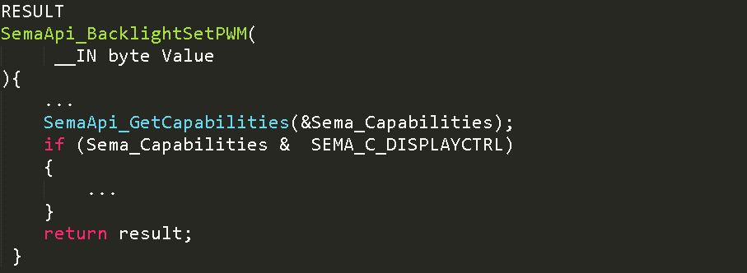
Example 2.

Slide 27
Example 2.
api.c
mock.c
Test case
dependent
Target.c
Notes:
因為我們在測的是目前這個C file 的程式碼。
其他的程式碼不是我們要測的，所以根本不需要。
寫一個假的取代掉就好了。
在強調一次，因為我們要測的只有當前這個C file，所以其他有相依性的function都必須隔離。

Slide 28
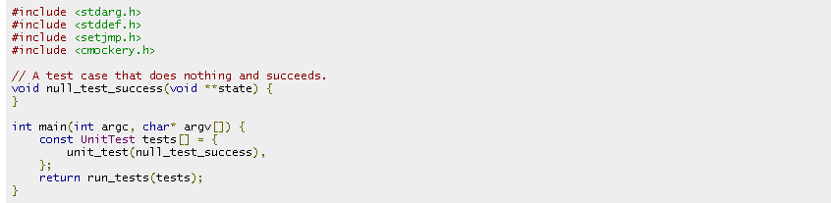
Test case writing
Unit Test Framework
cmockery

Slide 29


Stub/Mock methods
Verify inputs
Expect values
Return value

Slide 30
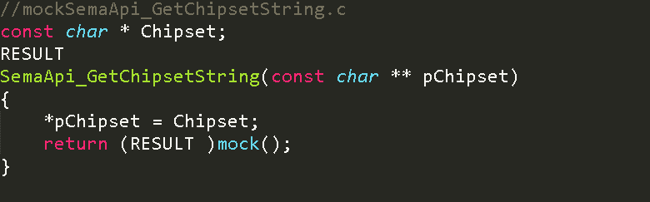
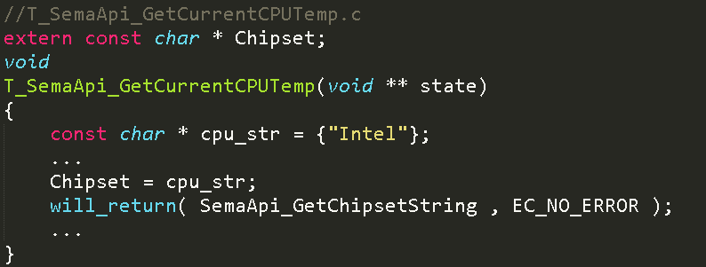
Example 1.

Slide 31
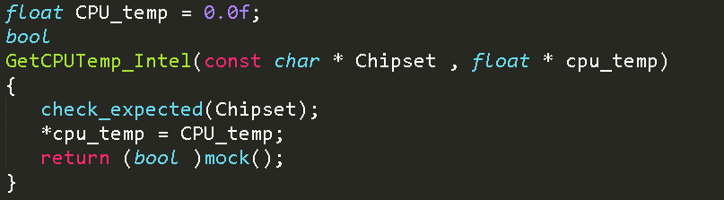
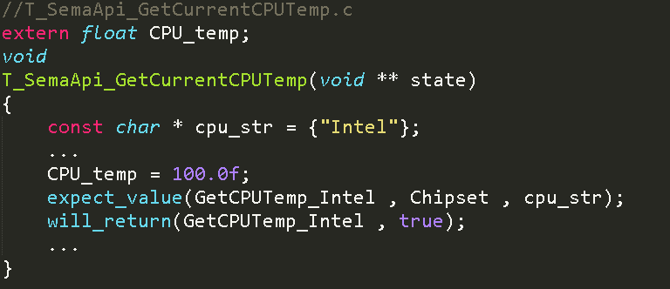
Example 2.

Slide 32
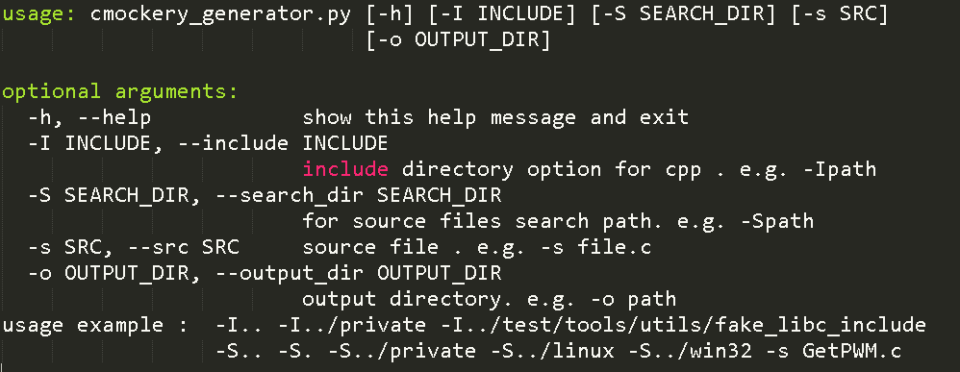
Tool – CTestCaseGen
CTestCaseGen
Github
git@github.com:locke12456/CTestCaseGen.git

Slide 33
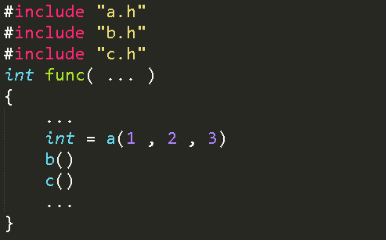
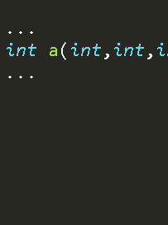
How it works
-Ia_file/
Path : C:/code/a_file/
include
a.h
b.h
c.h
-Sa_file/
Path : C:/code/a_file/
source
a.h

Slide 34
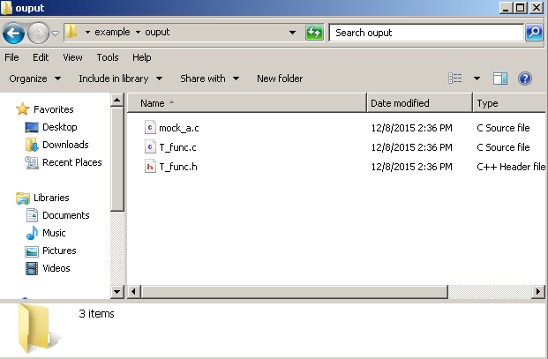
Command
python cmockery_generator.py –Ia_file/ -S. –Sa_file/ func.c

Slide 35
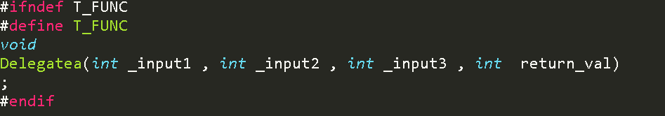
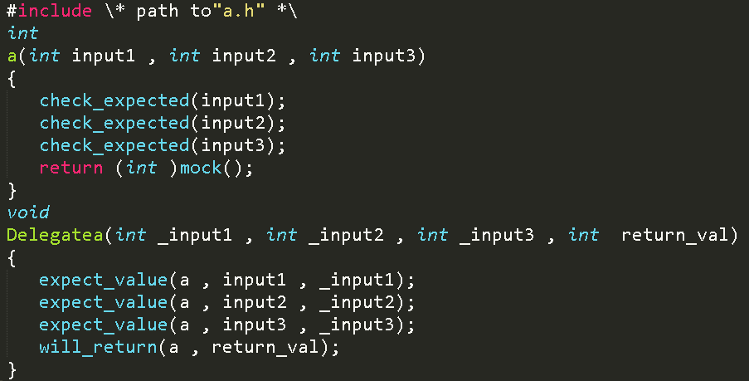
How it works

Slide 36
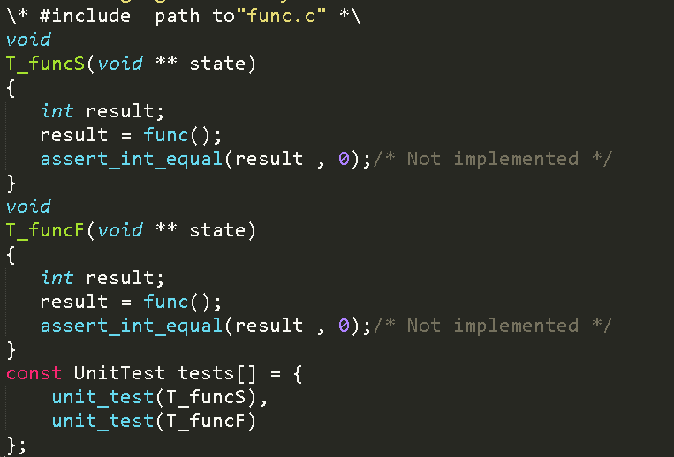

Slide 37
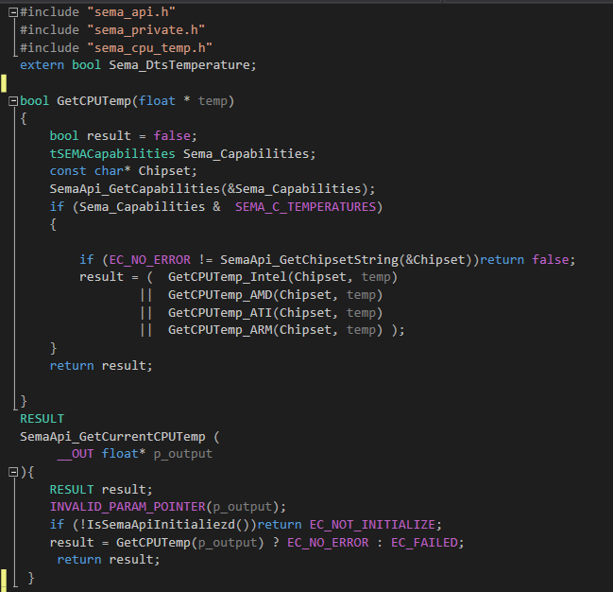
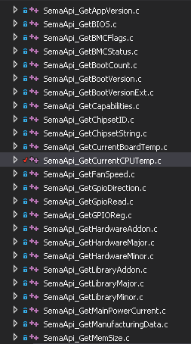
Test case writing
Target

Slide 38
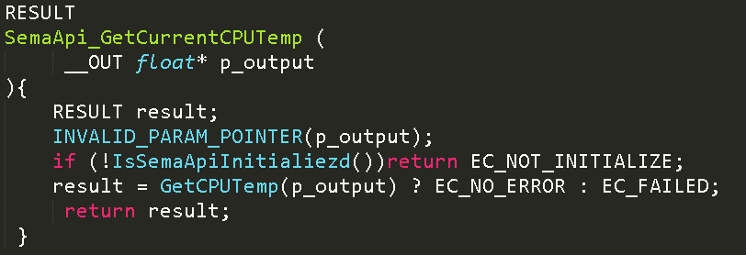

Slide 39
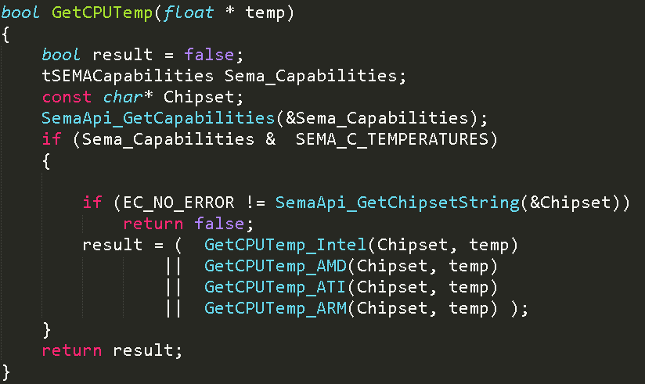

Slide 40
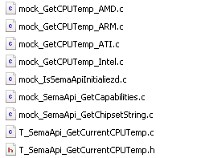
Example
Includes in Test case

Slide 41
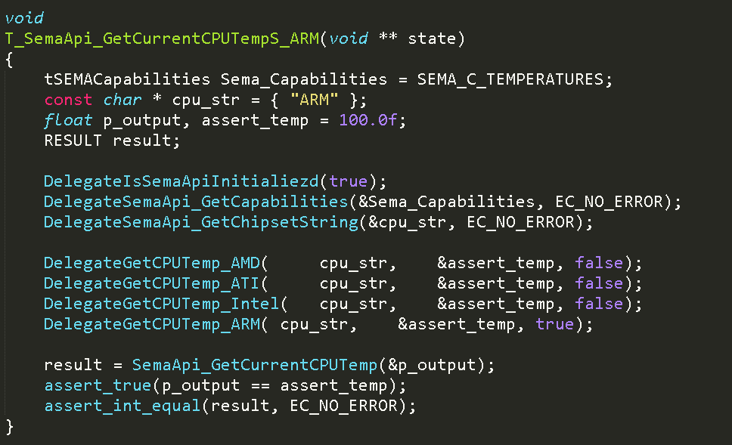

Slide 42
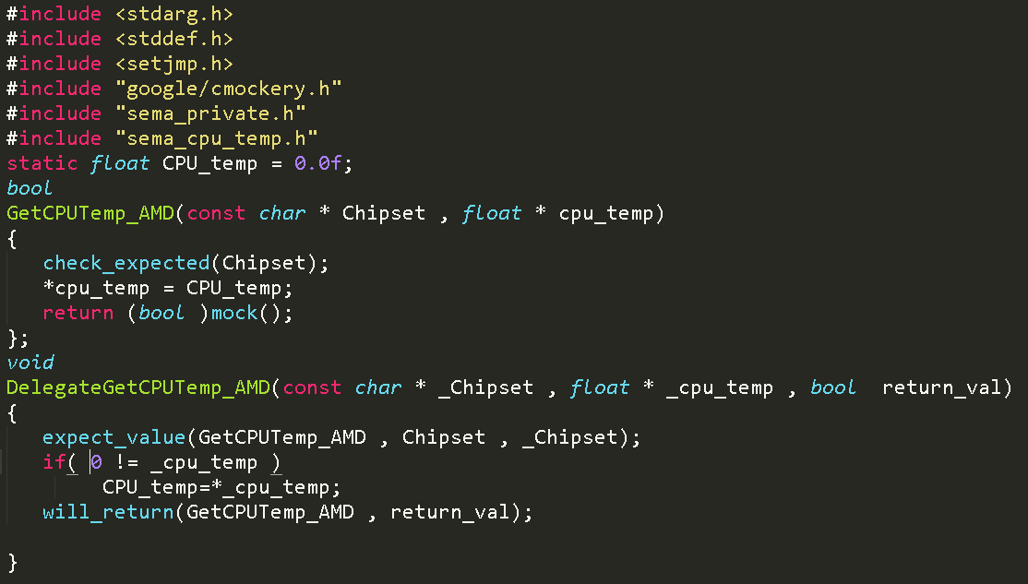

Slide 43
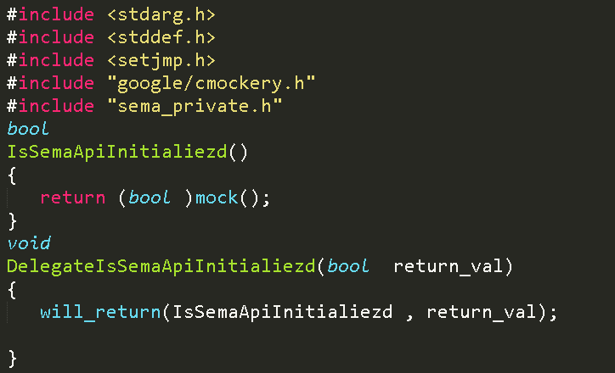

Slide 44
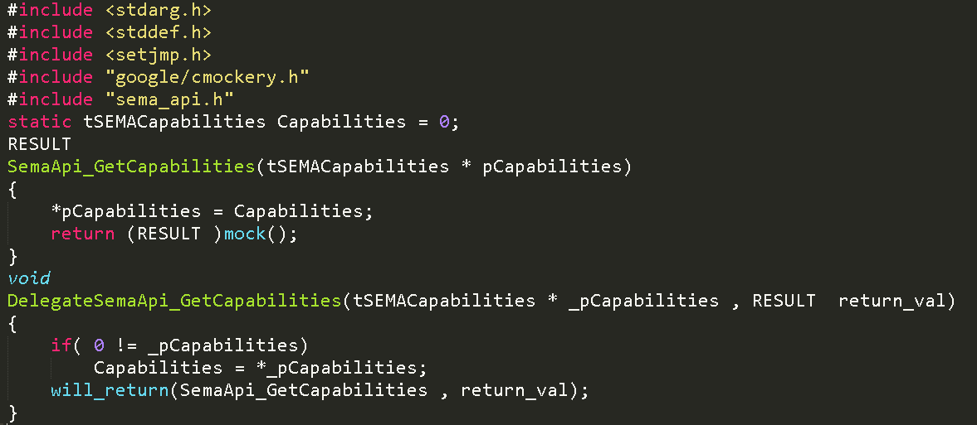

Slide 45
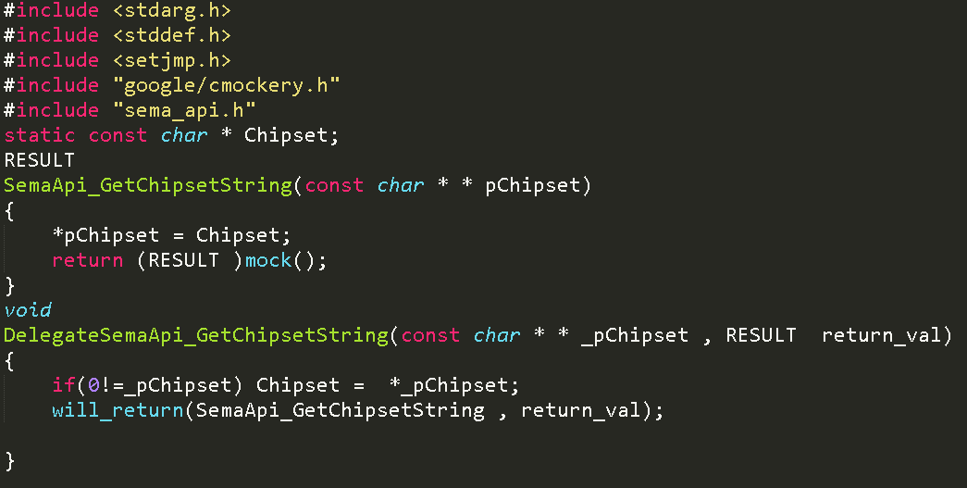

Slide 46
Q & A

Slide 47
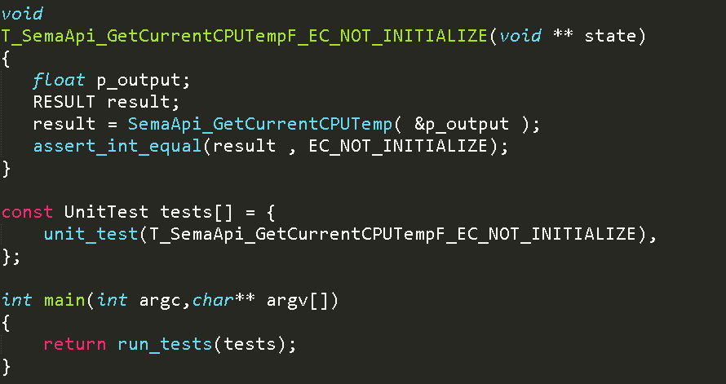

Slide 48
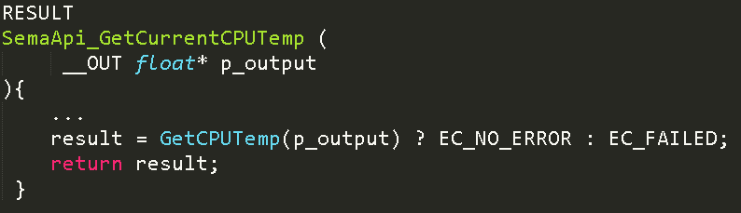

Slide 49
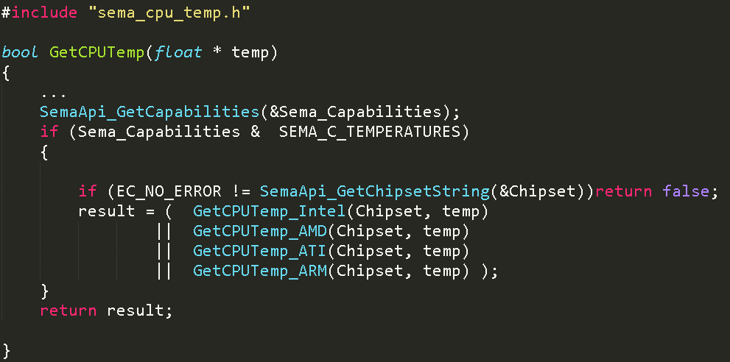

Slide 50
